Slide 1
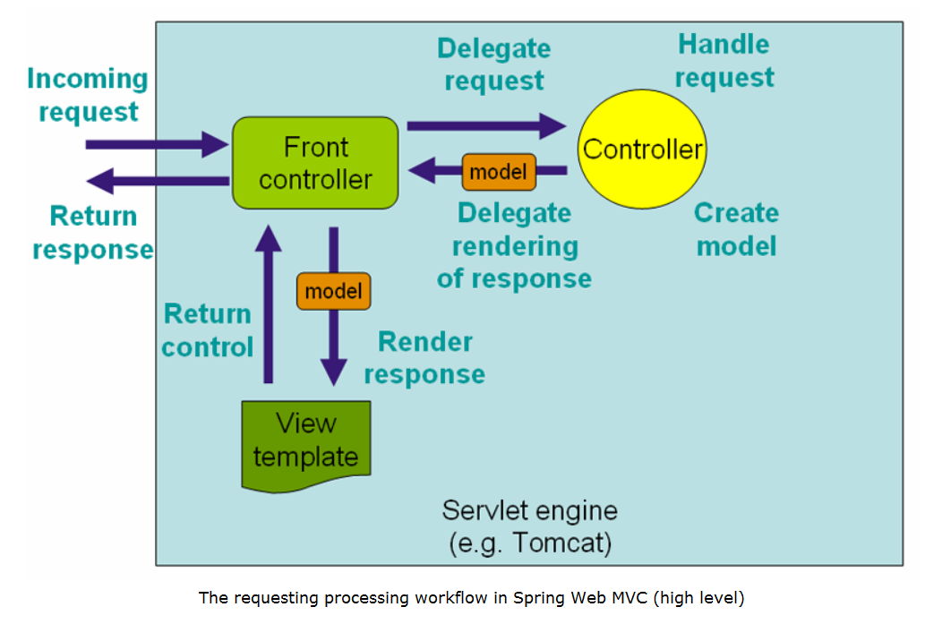
Security
Filter Chain
Filter chain Control
interception
Post
DAO
Get
Java
Services
Http
Post
Get
DTO
Hilbernate
Object
Relation
Mapping
Jsp.-pages
HTML5,CSS, JavaScript,
Jquery, JSTL,SpringTags
PG-Admin
Database

